Slide 1
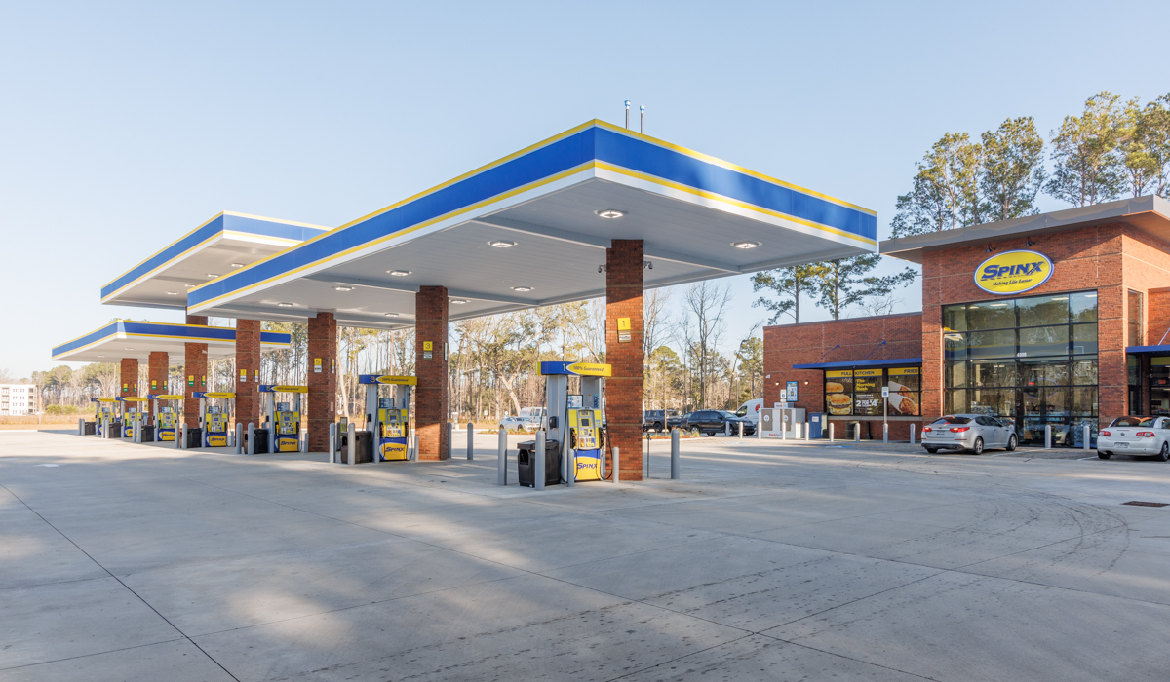
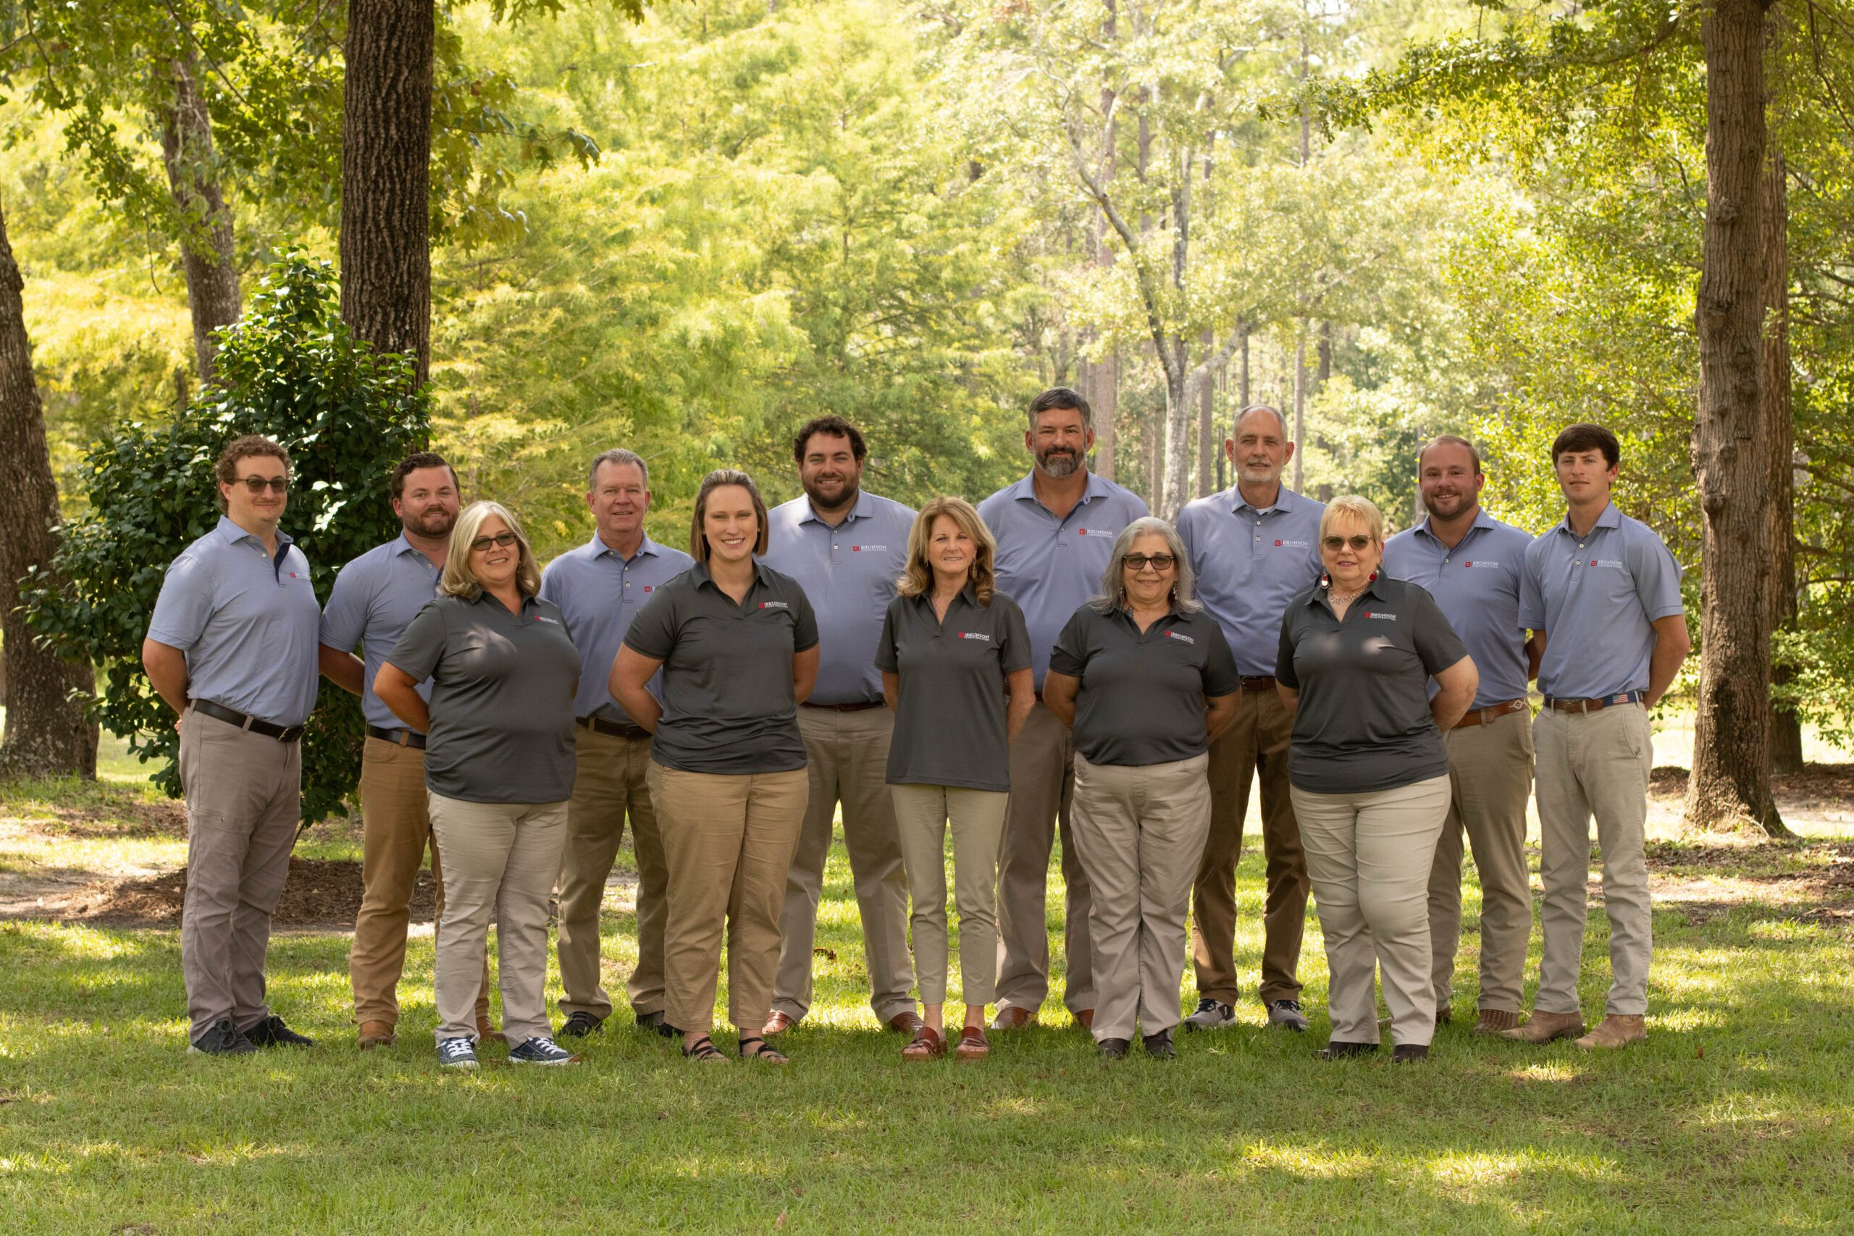
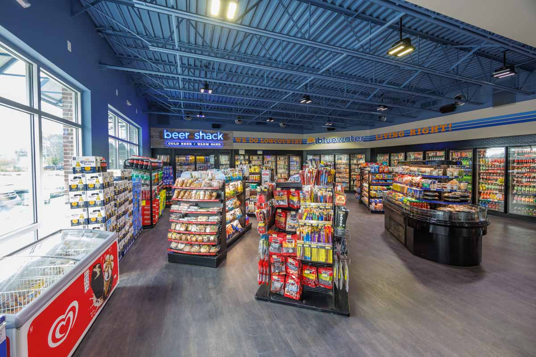
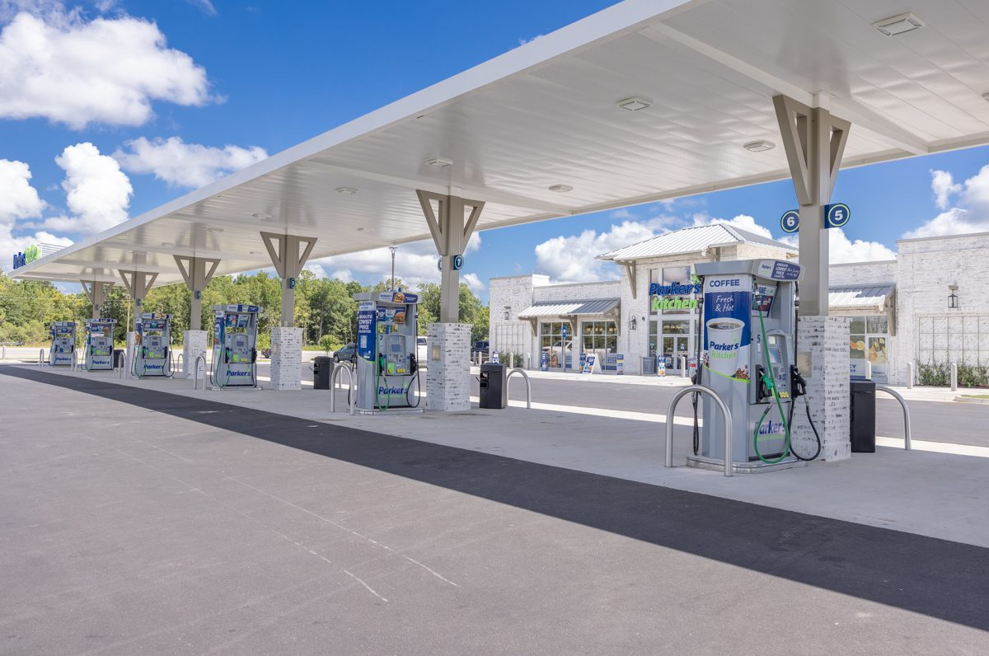

Your C-Store
Construction Specialists
Serving the Southeast for over 75 Years

Slide 2
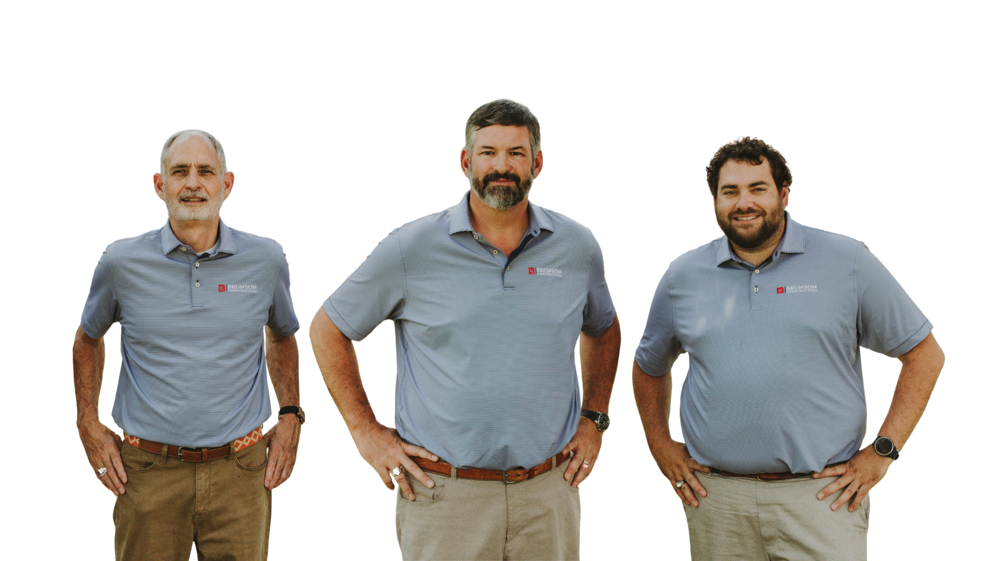
Meet Our Leadership Team
Wallie Hiers
PRESIDENT
Gregg Brunson
SENIOR VICE PRESIDENT
Chase Hiers
VICE PRESIDENT

Slide 3
your C-Store construction Specialists
Critical Expertise in High-Visibility, High-Traffic Retail Spaces

Slide 4
Brunson is Built for C-Stores
Over 75 years building and renovating convenience stores across South Carolina and Georgia
Experience with regional chains and single-site developers
Proven in ground-up builds, remodels, and multi-site developments
Experienced in fuel equipment systems, car wash integrations, and canopy systems
Collaborate with fast food tenants or in house food service arrangements

Slide 5

Brunson is Built for C-Stores
Dozens of convenience store projects have been completed throughout South Carolina and Georgia over the past 25 years

Slide 6
What C-Store construction Managers Value
We Understand What You’re Up Against

Slide 7
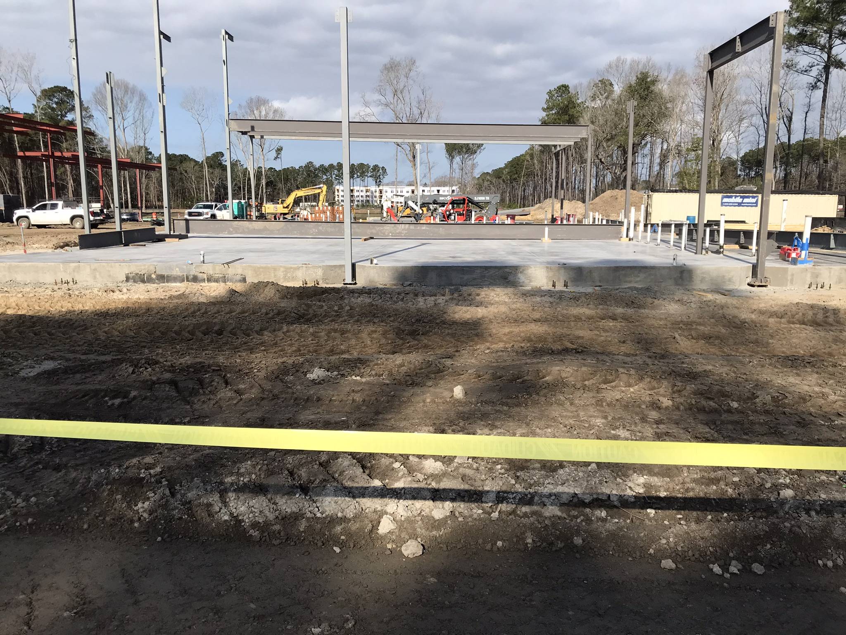
Project Challenges
Tight Schedules
Time is money when locations generate daily revenue
Permit & Inspection Coordination
Delays between design teams and municipalities
Utility Coordination
Water, sewer, natural gas, power — no room for surprises
High-Quality Finishes
Inconsistent quality of work

Slide 8
Challenge Accepted
Tight Schedules
180 - 220 day typical project completion
Permit & Inspection Coordination
Proactive, hands-on approach to solving problems
Utility Coordination
Early collaboration with utility suppliers
High-Quality Finishes
Self-performing capabilities and dedicated finishing crews

Slide 9
Our Process, Your Advantage
Simplifying the Build — So You Can Focus on Opening the Doors

Slide 10
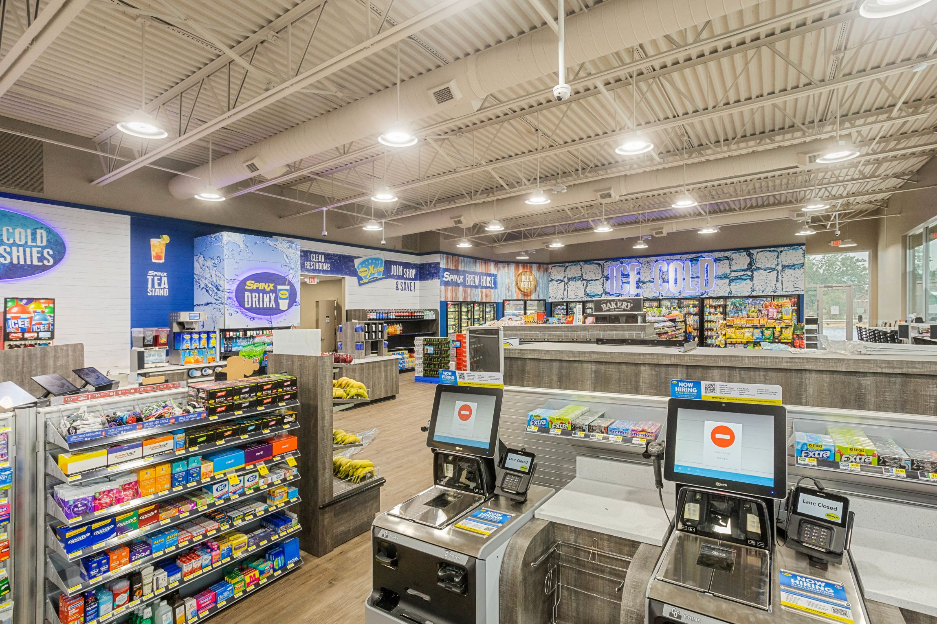
Our Experience in Action
Our Approach
Self-performing components
Dedicated finishing crews
Strong relationships with reliable and experienced subcontractors
Proactive scheduling & transparent reporting
Accessible leadership
Your Outcome
Faster mobilization
Fewer delays
Fewer punch list issues
No surprises
Fewer headaches
Quicker completions

Slide 11




Trusted By Leading Regional Brands

Slide 12
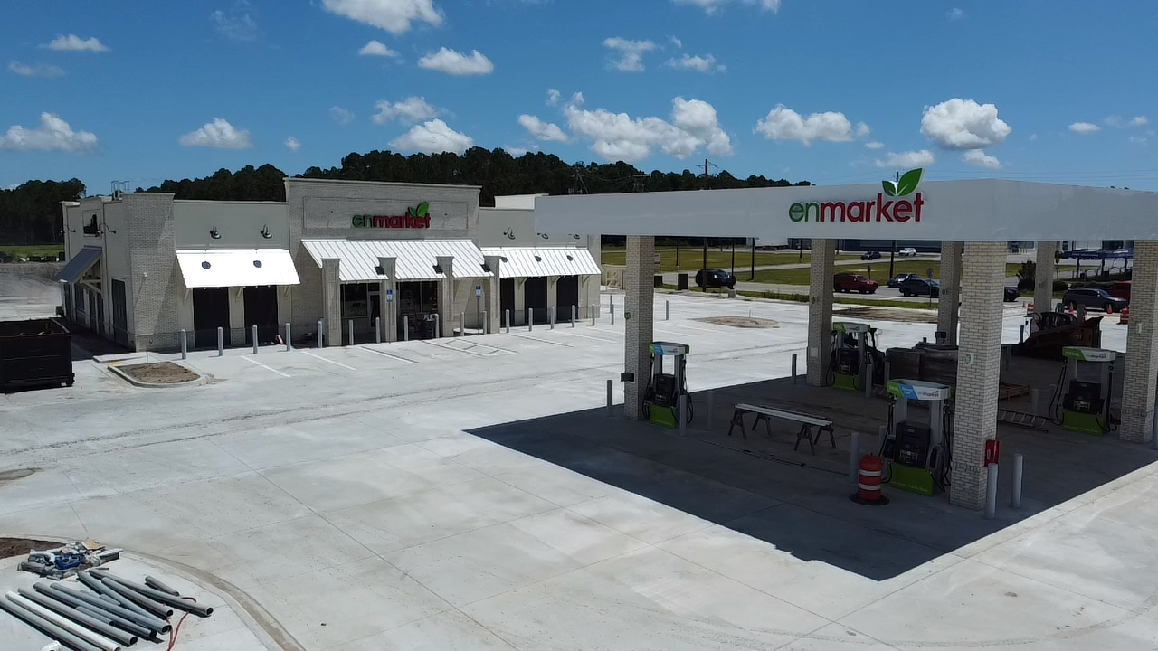
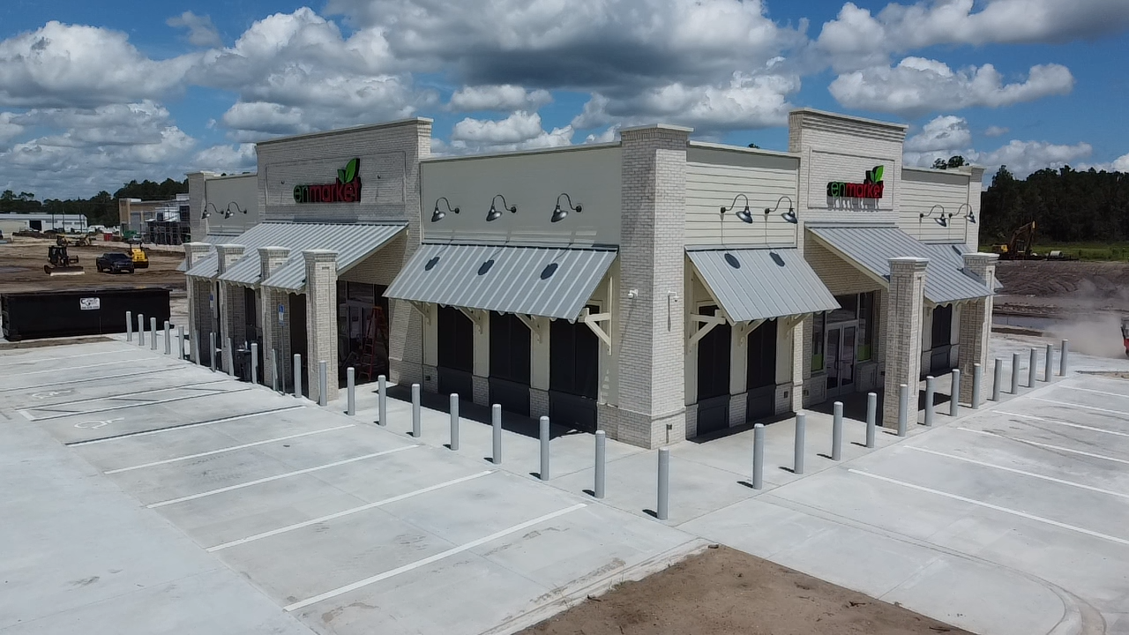
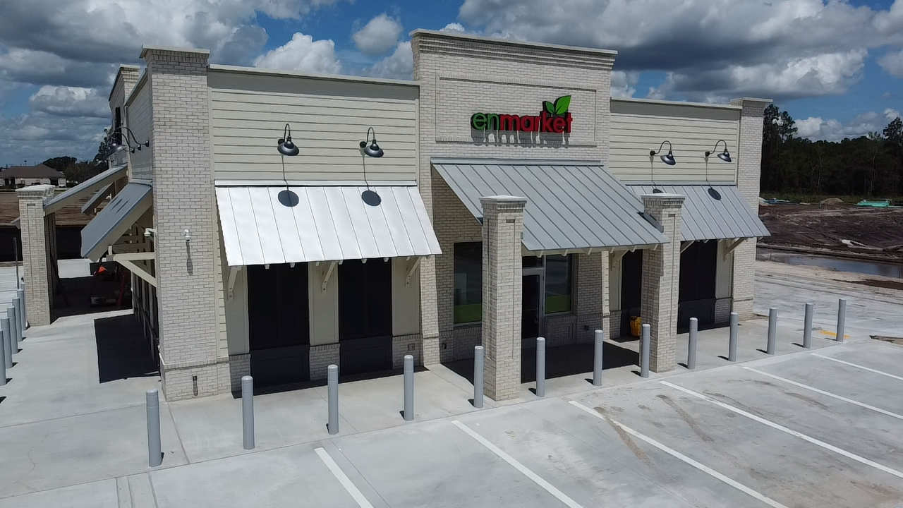
enmarket #865
Kingsland, GA
Brunson Construction Project Manager: Bobby Hass
enmarket Construction Manager:
Justin Polk
8 auto fuel dispensers
6,120 sq ft convenience store with custom commercial kitchen
4,950 sq ft auto fueling canopy
37,400 sq ft of heavy duty concrete paving

Slide 13

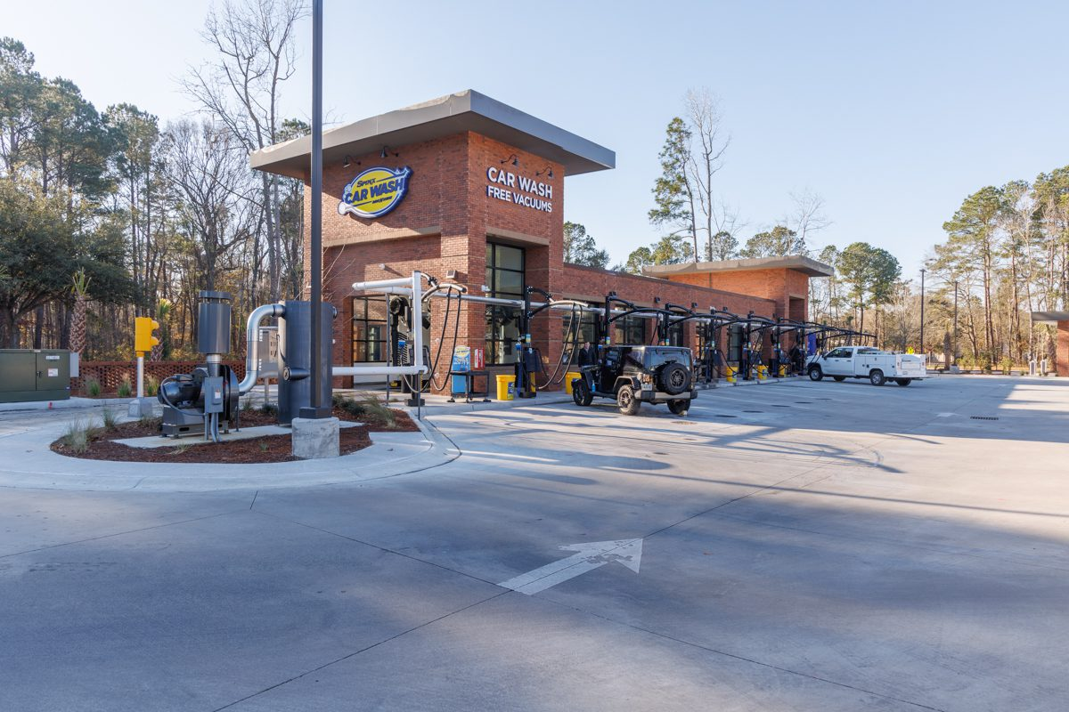
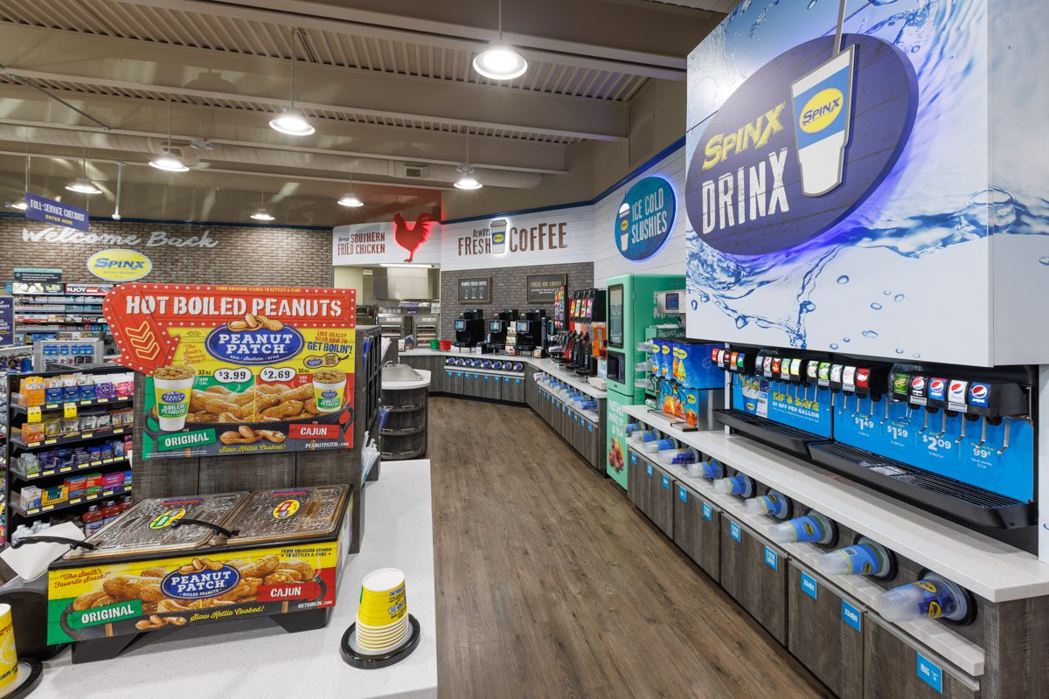
Spinx #368
Charleston, SC
Brunson Construction Project Manager: Bobby Hass
The Spinx Company Construction Manager: Brian Price
7 auto fuel dispensers
5,200 sq ft convenience store with custom commercial grade kitchen and appliances
2,700 sq ft auto fueling canopy
State of the art tunnel express carwash
80,800 sq ft of heavy duty concrete paving

Slide 14
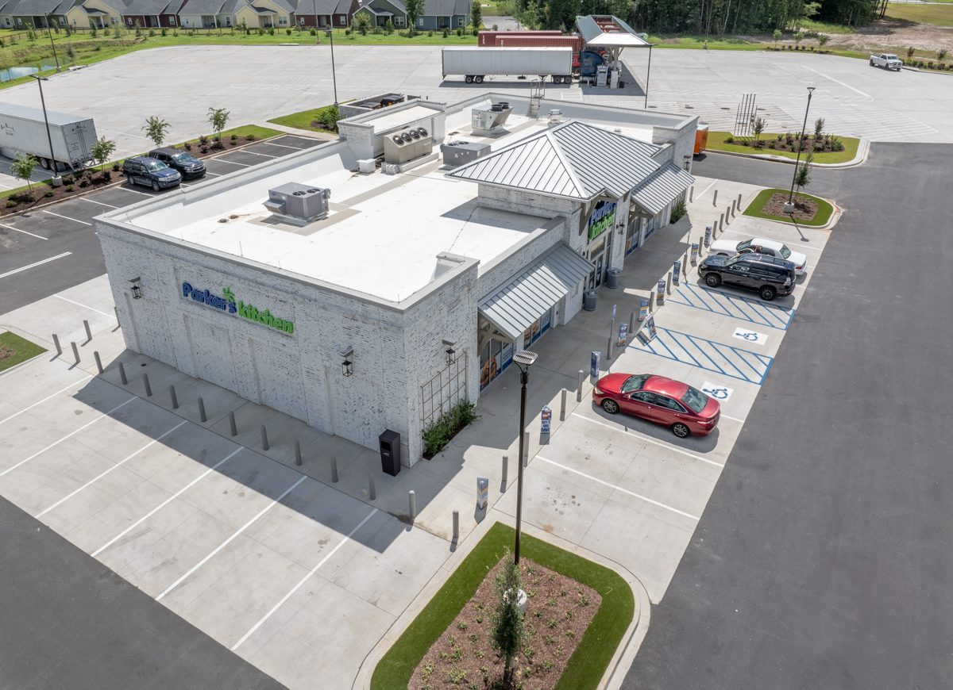
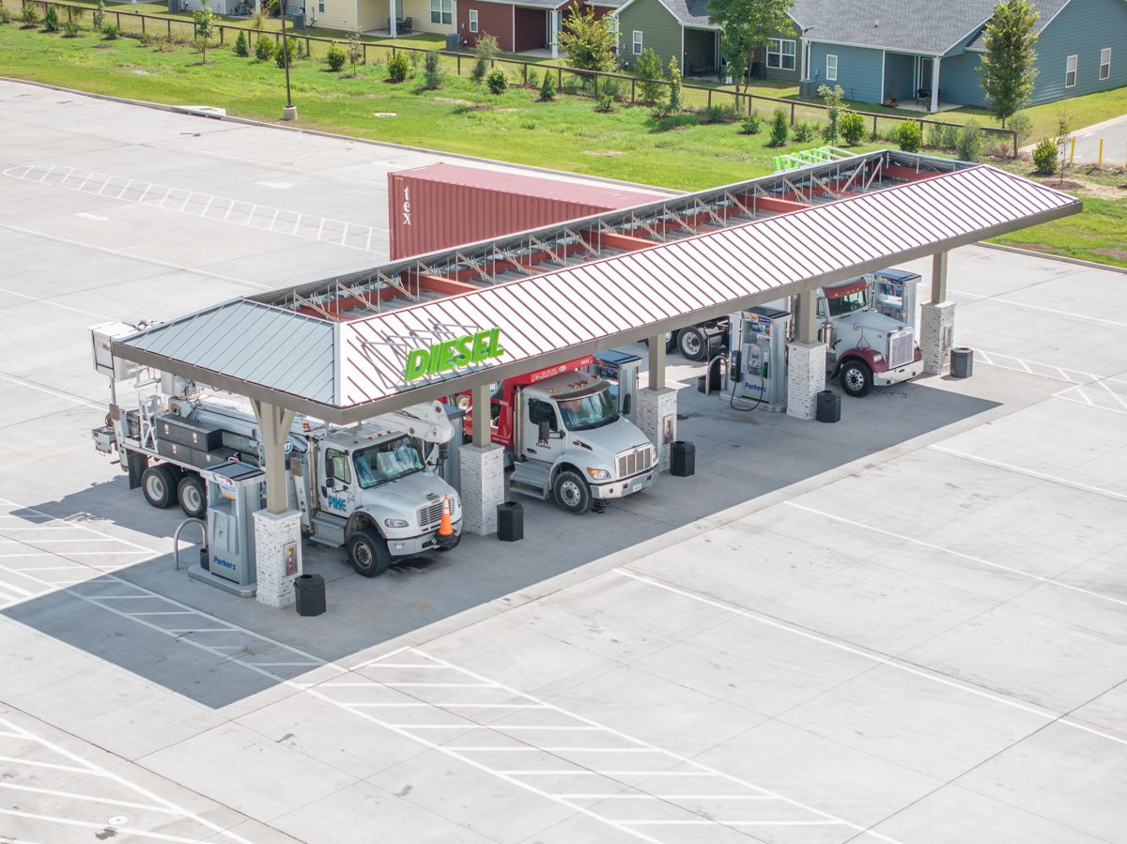
Parkers #102
Rincon, GA
Brunson Construction Project Manager: Chase Hiers
Parker's Kitchen Construction Manager: Eric Hoffman
8 auto fuel dispensers and 5 truck diesel dispensers
5,100 sq ft convenience store with custom commercial kitchen
5,745 sq ft auto fueling canopy
2,040 sq ft truck diesel canopy
92,587 sq ft of heavy duty concrete paving

Slide 15
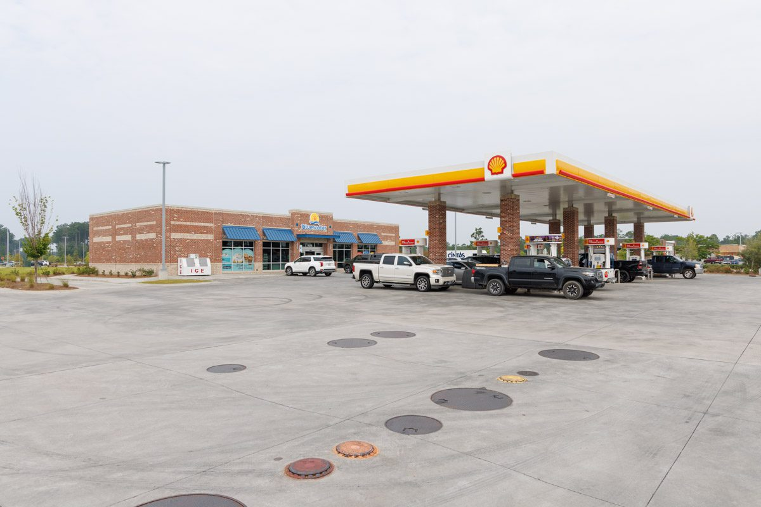
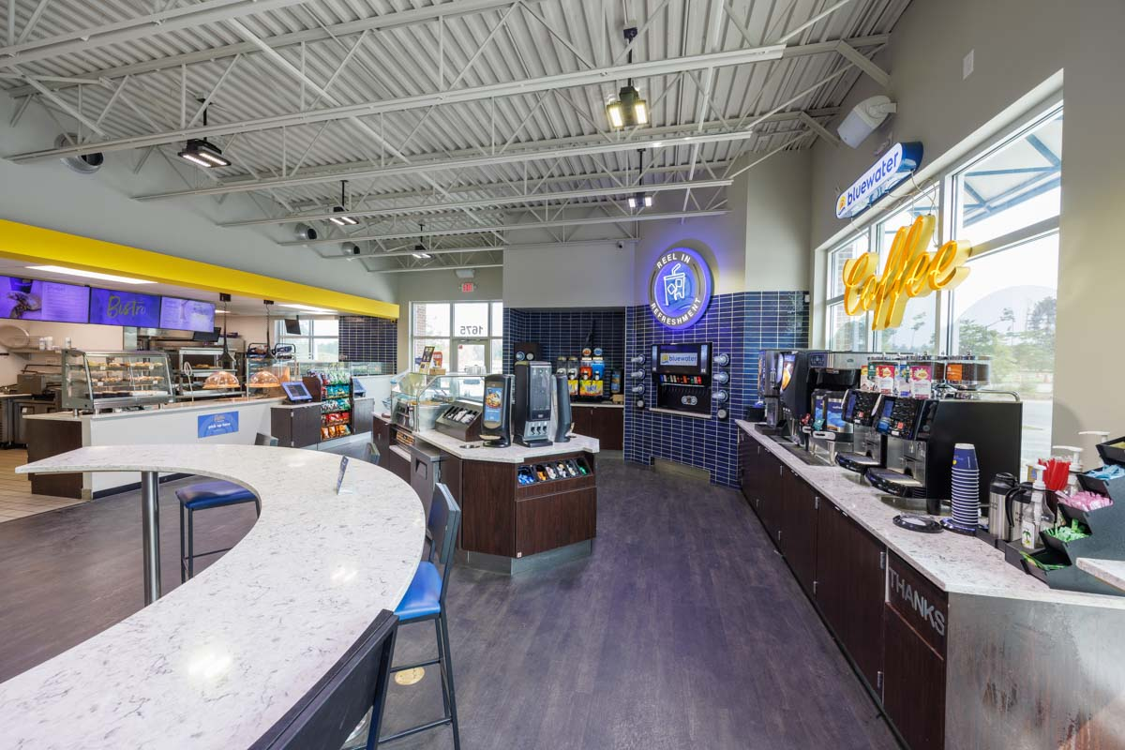
Bluewater #28
Summerville, SC
Brunson Construction Project Manager: Bobby Hass
Bluewater Construction Project Manager: Fred Whittle
8 auto fuel dispensers
5,500 sq ft convenience store with custom Bistro kitchen
4,104 sq ft auto fueling canopy
Express carwash
32,260 sq ft of heavy duty concrete paving

Slide 16
Why Brunson?
Your Ideal Partner
for C-Store Construction

Slide 17
C-Store
Specialists
Experienced leadership
78 years of combined leadership experience
Self-Performing Capabilities
Greater control, better quality
Direct Access to owners
Quick answers, fast decisions
Dedicated Finishing Crew
Projects finish strong with predictably high quality finishes
Transparency & Trust
Integrity and clear communication
Lead Coordination of specialty contractors
Fuel equipment and canopy companies, car wash equipment, and food service

Slide 18
Let’s build something together.
Let us show you how Brunson builds better - from fuel tank installs to final inspection.
brunson-construction.com 803-943-2619 616 Railroad Ave W, Hampton, SC 29924

